Slide 1
Digital Portfolio
STUDENT NAME: Rakesh pp
REGISTER NO AND NMID: asbruce2428c0559
DEPARTMENT: BSc AIML
COLLEGE: COLLEGE/ UNIVERSITY JCT COLLEGE OF ARTS AND SCIENCE/BHARATHIYAR UNIVERSITY

Slide 2
AI Virtual Assistant

Slide 3


AGENDA
Problem Statement
Project Overview
End Users
Tools and Technologies
Portfolio design and Layout
Features and Functionality
Results and Screenshots
Conclusion
Github Link
3/21/2024 Annual Review

Slide 4

PROBLEM STATEMENT
In today's fast-paced digital world, users are overwhelmed by the sheer volume of tasks, information, and applications they interact with daily. From managing schedules and retrieving information to controlling smart devices and navigating online services, the need for a centralized, intelligent, and intuitive assistant has become more critical than ever.
Despite the availability of various digital tools, most users still rely on fragmented systems that lack natural interaction, personalization, and contextual understanding. This leads to inefficiencies, cognitive overload, and reduced productivity.
This project aims to develop an AI-powered Virtual Assistant that can understand natural language commands, respond intelligently, and perform a wide range of tasks—bridging the gap between human intent and digital execution. The assistant will offer voice and text-based interaction, integrate with web services and local applications, and learn user preferences to deliver a personalized experience.
Let me know if you'd like to tailor this for a specific audience—like academic submission

Slide 5

PROJECT OVERVIEW
In an era defined by digital acceleration, the demand for intelligent, voice-enabled systems that simplify human-computer interaction is rapidly growing. This project aims to develop an AI Virtual Assistant capable of understanding natural language input (both voice and text), executing user commands, and delivering contextual responses across a range of tasks.
The assistant will serve as a personal productivity tool, offering features such as information retrieval, task automation, reminders, and web-based services—all through intuitive, conversational interaction. By leveraging natural language processing (NLP), speech recognition, and machine learning, the assistant will bridge the gap between user intent and digital execution.

Slide 6

WHO ARE THE END USERS?
1. Students and Learners
Use the assistant to set study reminders, answer academic questions, summarize topics, and manage schedules.
Ideal for helping with research, language translation, or even preparing for exams.
2. Working Professionals
Automate daily tasks like sending emails, scheduling meetings, or retrieving data.
Can act as a productivity booster by integrating with calendars, task managers, and communication tools.
3. Home Users
Control smart devices, play music, check weather, or get cooking tips—all hands-free.
Useful for elderly users who benefit from voice interaction over complex interfaces.
4. Small Business Owners
Manage appointments, track inventory, respond to customer queries, and automate repetitive tasks.
Can be customized to handle business-specific workflows.
5. Visually Impaired or Differently Abled Users
Voice-based interaction makes technology more accessible.
Can assist with reading texts aloud, navigating apps, or performing tasks without screen reliance.

Slide 7

TOOLS AND TECHNIQUES
🔧 Tools Used
This project is built using Python, a versatile language ideal for AI and automation. For speech recognition, libraries like SpeechRecognition, PyAudio, and Vosk are used to capture and convert voice input into text. To enable the assistant to speak back, text-to-speech tools such as pyttsx3 and gTTS are implemented.
For understanding user commands, Natural Language Processing (NLP) is handled using spaCy, NLTK, and transformers from Hugging Face. These tools help interpret intent and generate meaningful responses. Real-time data like weather, news, and general knowledge is fetched using APIs such as OpenWeatherMap, NewsAPI, and Wikipedia API.
If a graphical interface is needed, frameworks like Tkinter or PyQt5 can be used to build a simple desktop GUI. For storing user preferences or reminders, optional databases like SQLite or Firebase are integrated. Development is carried out using editors like VS Code or PyCharm, with Git and GitHub used for version control and collaboration.
🧪 Techniques Applied
The assistant uses voice processing to convert spoken input into text, followe

Slide 8
POTFOLIO DESIGN AND LAYOUT
The portfolio design follows a clean, modern, and user-friendly layout that highlights the AI Virtual Assistant project in an organized way. The homepage introduces the project title with a minimalist banner, followed by sections such as Overview, Objectives, Tools & Technologies, System Design, and Implementation. A grid-based structure with icons and visuals ensures clarity and readability, while consistent typography and color schemes maintain a professional look. Interactive elements, such as project screenshots, flow diagrams, and a demo section, are included to make the portfolio engaging and visually appealing.
8

Slide 9
FEATURES AND FUNCTIONALITY
Voice and Text Interaction
Supports both speech recognition and text-based commands for flexible communication.
Natural Language Processing (NLP)
Understands user queries and responds intelligently with relevant information.
Task Management
Sets reminders, checks the time/date, and manages simple daily tasks.
Information Retrieval
Provides instant answers, weather updates, and web search results.
Web and Application Control
Opens websites, applications, and services on user request.
Personalized Responses
Learns user preferences over time for improved interaction.
Expandable Modules
Can be extended to include music playback, IoT device control, or chatbot integration.

Slide 10
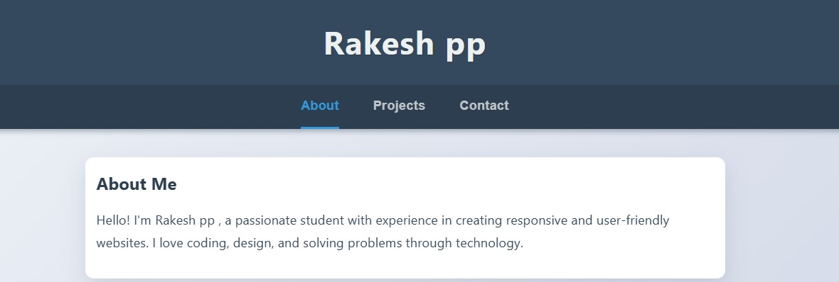

RESULTS AND SCREENSHOTS
3/21/2024 Annual Review
10

Slide 11
CONCLUSION
The AI Virtual Assistant project demonstrates the potential of combining speech recognition, natural language processing, and task automation to create an intelligent, user-friendly system. It successfully handles basic tasks such as answering questions, retrieving information, setting reminders, and controlling applications, thereby improving efficiency and accessibility in daily life. The project highlights how AI can bridge the gap between humans and machines by enabling natural interaction. With further development and integration of advanced features like IoT control, machine learning–based personalization, and multi-language support, the assistant can evolve into a more powerful and versatile tool.
11

